Slide 1
AUTONOMOUS SAILBOAT FOR WATER QUALITY MONITORING
ASWQM
DR/ Rasha Fathi

Slide 2
Omnia Mahmoud Ismail
Youssef Ahmed Hosny
Mohamed Mohsen Mansour
Waleed Ebrahim Mohamed
Hala Mohamed Hemaida
Group Members

Slide 3
Table of contents
01
02
03
Problem Statement & Project Idea
Monitoring
Mobile Application
04
05
06
Business Plan
Future Work
HW Implementation

Slide 4
01
Problem Statement

Slide 5
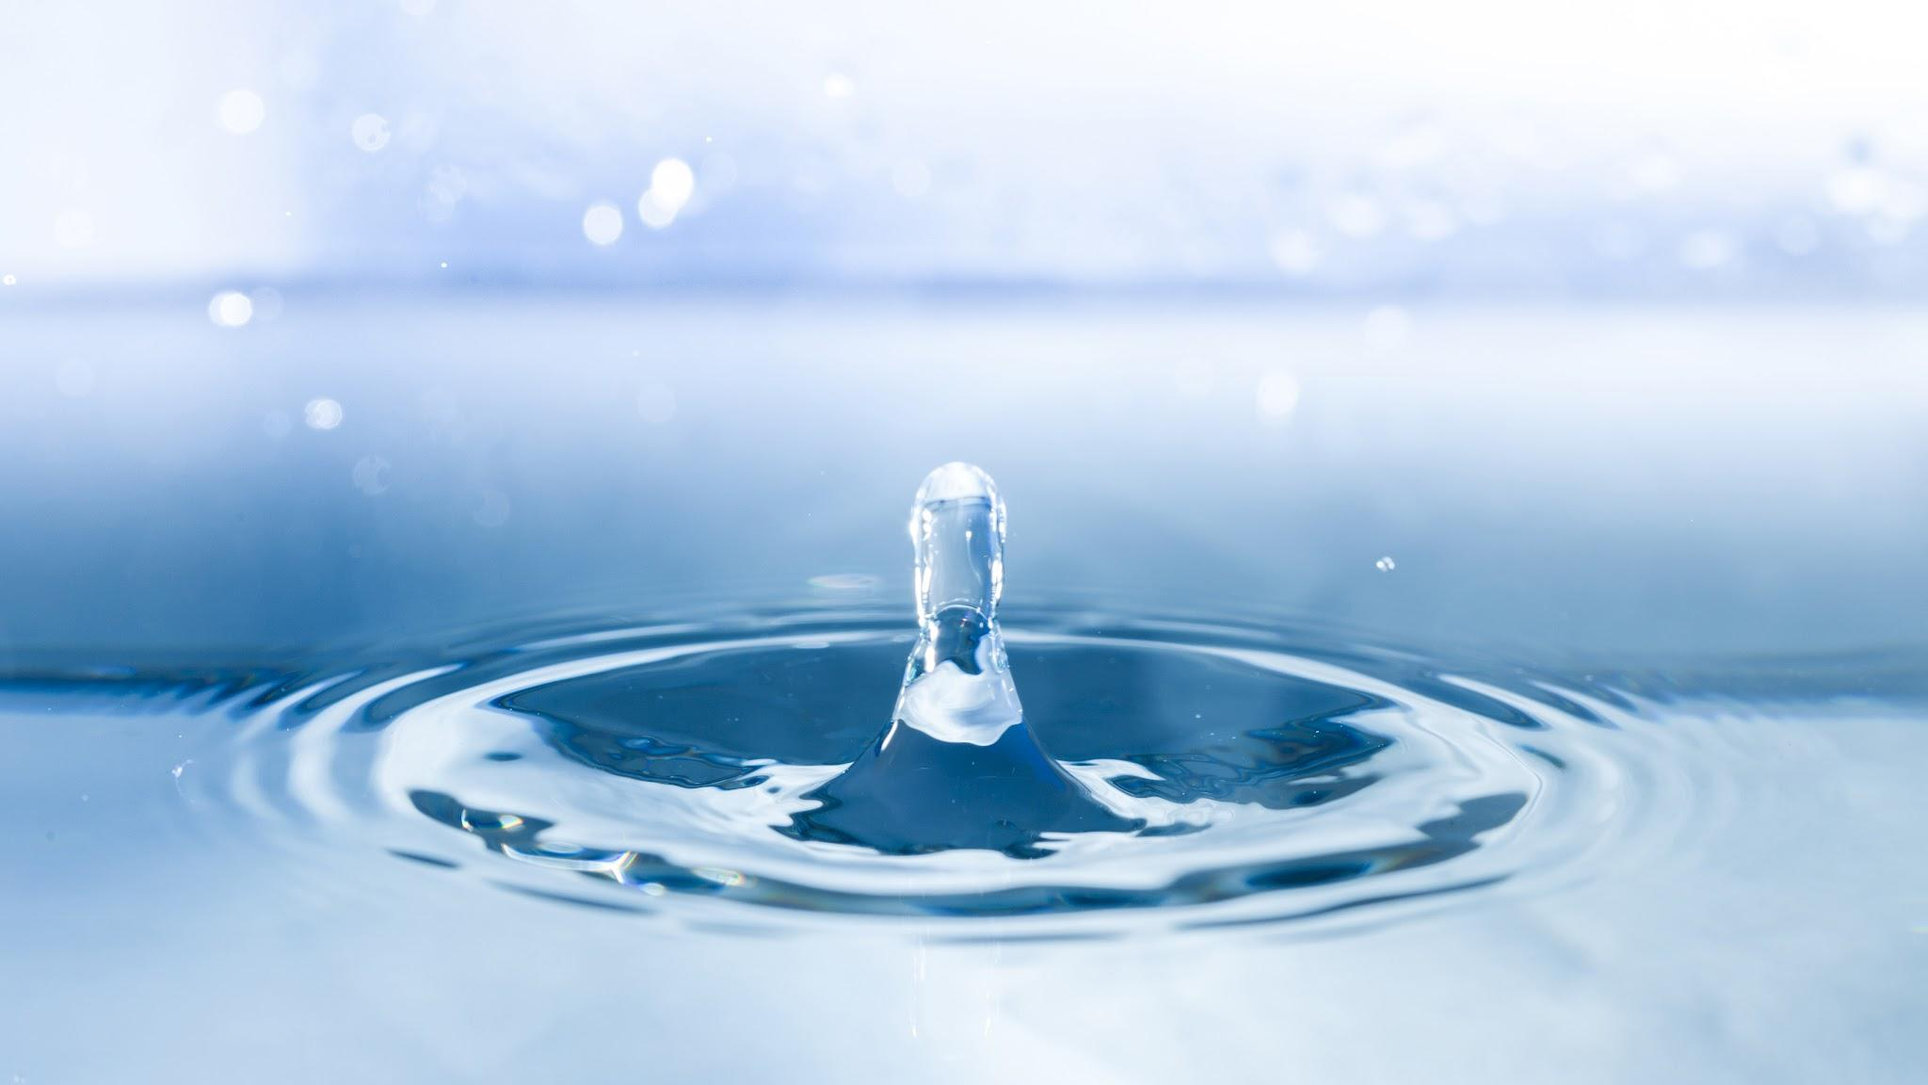
“We never know the worth of water until the well is dry.”
—Thomas Fuller

Slide 6
How is water quality traditionally monitored?
Traditionally, water quality monitoring relies on manual systems of data collection sampling. Sensors are placed at stations to record data, with a sample taken from each and sent to a laboratory for analysis. It is time consuming, costly and inefficient, creating difficult conditions to compare or assess the various water quality parameters.

Slide 7
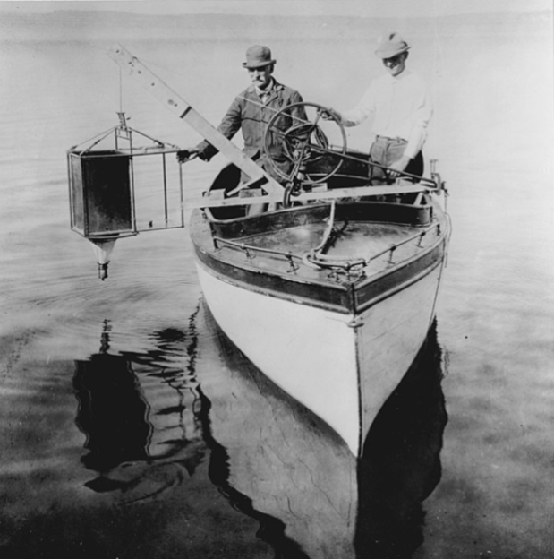
How is water quality traditionally monitored?(cont.)
Another way to monitor called regional approach used to monitor individual lakes and rivers instead of building station, this way takes sample of water and send to laboratory, this way still slow and can’t recognize the emergency quickly.
Fig(1): Edward and Chancy monitor plankton on Madison’s Lake

Slide 8
SO
WHAT IS THE
SOLUTION

Slide 9

01
Project Idea

Slide 10

Main Feachers

Slide 11
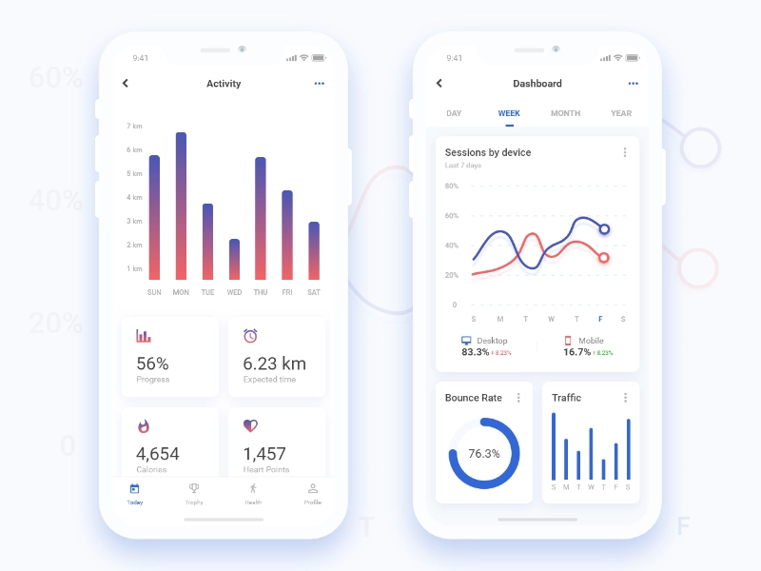
Water Quality Monitoring
Using not expensive sensors to achieve monitoring
Check water quality remotely
Achieve Real Time and Easy Information
Quality Classification According to User’s needs

Slide 12
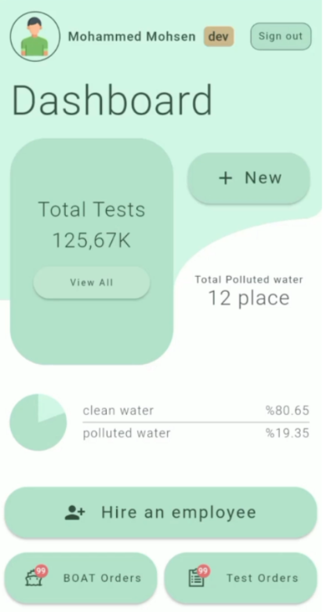
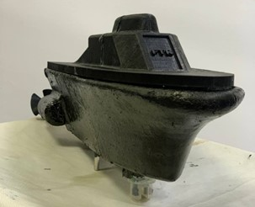
Mobile application
Send location
User who controls the Boat sends new Location to Boat by using Bluetooth module.

Slide 13
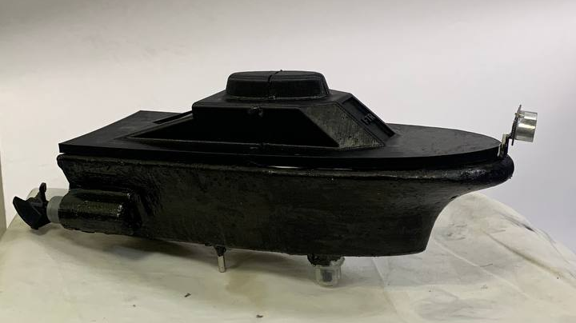
Boat Control
Using MPU and GPS Sensors to Navigate.
Communicating with mobile through Bluetooth Waves.
Autonomous Moving by just one Click.
Holding Water Sensors.
Using PID Algorithm.

Slide 14
02
Monitoring Sensors

Slide 15
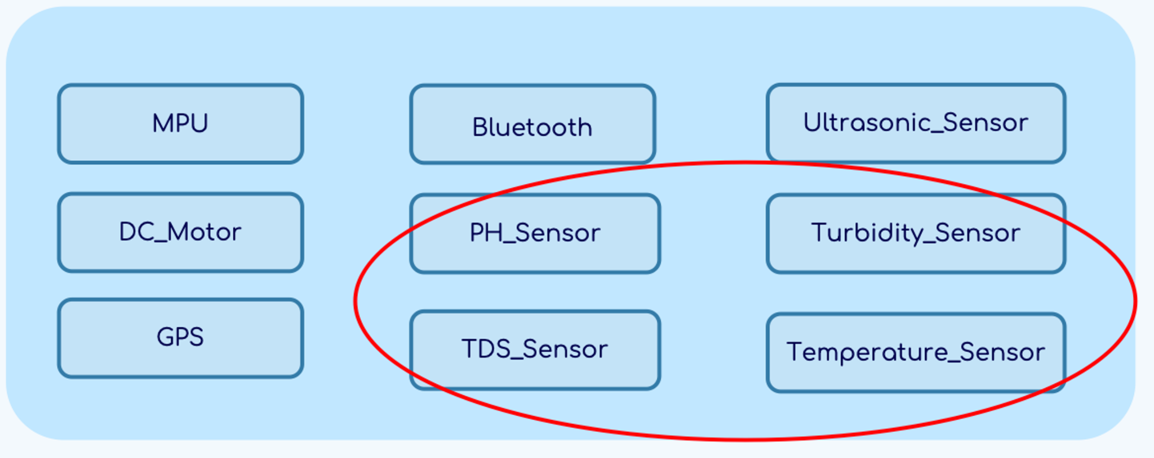
Monitoring Sensors

Slide 16
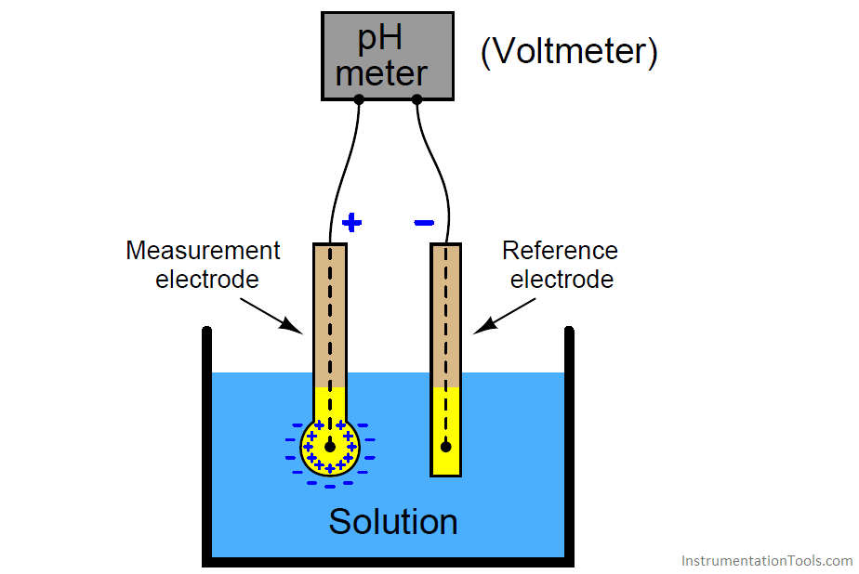
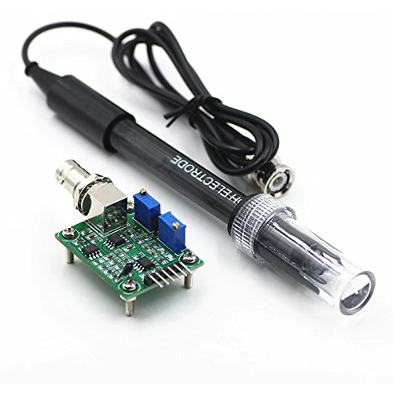
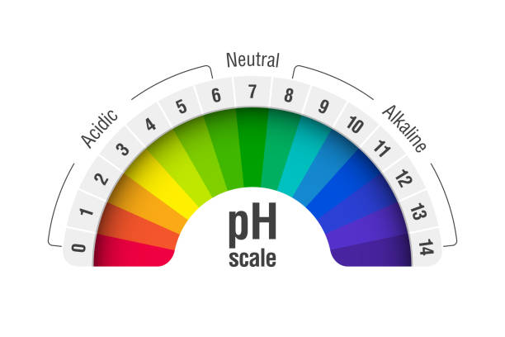
pH Sensor
Role
A pH sensor measures the acidity or alkalinity of the water with a value between 0-14.
How it works?
pH probes contain two electrodes (a sensor electrode and a reference electrode) that measure the hydrogen-ion activity in a solution. The exchange of ions generates a voltage that is measured by the pH meter converting the voltage into a readable pH value.
pH Scale
The range goes from 0 - 14, with 7 being neutral. pH of less than 7 indicate acidity, whereas a pH of greater than 7 indicates a base.
Drinking water pH value is between 6.5- 8.5

Slide 17
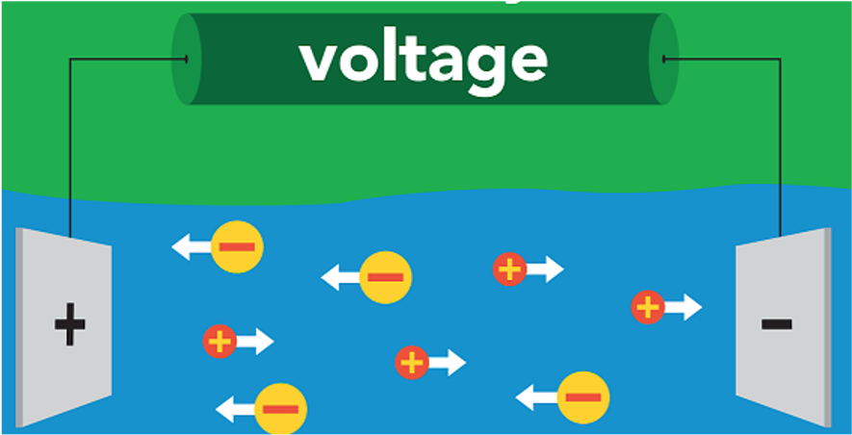
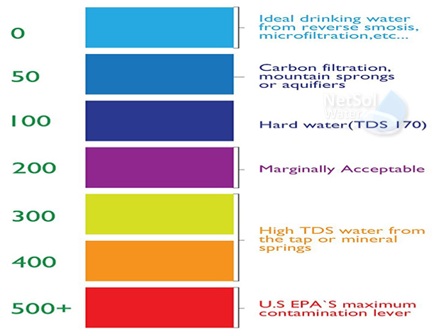
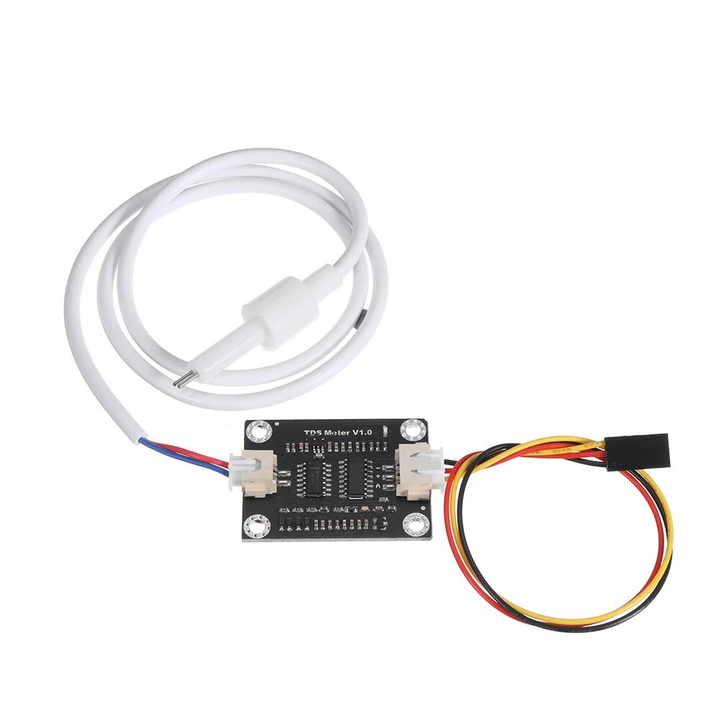
TDS Sensor
Role
TDS (Total Dissolved Solids) indicates how many milligrams of soluble solids are dissolved in one liter of water. In general, the higher the TDS value, the more soluble solids are dissolved in water, and the less clean the water is.
Milligram/ liter is known as Part Per Million ppm.
How it works?
A TDS meter is basically an electrical charge meter which have two electrodes.
If the water contains no soluble materials and is pure, it will not conduct a charge and will have a 0-ppm.
If the water is full of dissolved materials, it will conduct a charge, with the resulting ppm will be proportional to the number of dissolved solids.
TDS in PPM Scale
TDS is measured as a volume of water with the unit ppm. According to the EPA secondary drinking water regulations
Ideal Drinking water has 0 ppm, 500 ppm is contamination lever above it water isn’t drinkable.
Average tap water has 100-400 ppm

Slide 18
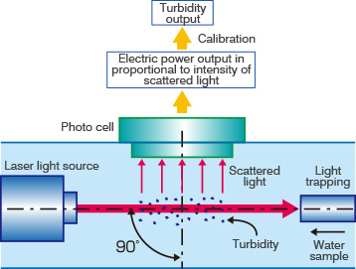
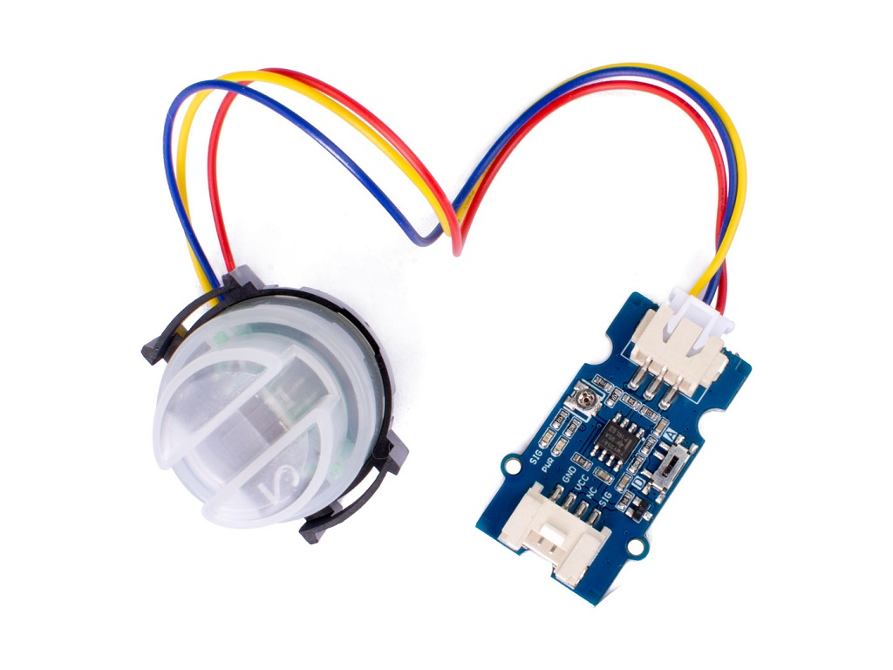
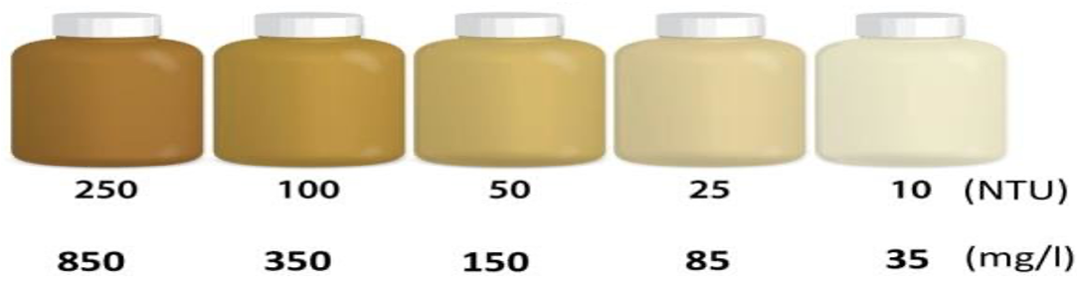
Turbidity Sensor
Role
The turbidity sensor detects water quality by measuring the levels of turbidity, or the opaqueness.
used to measure the turbidity of a fluid or the presence of suspended particles in water.
How it works?
A turbidity probe works by sending a light beam into the water to be tested. This light will then be scattered by any suspended particles. A light detector is placed at a 90 degree angle to the light source, and detects the amount of light that is reflected back at it.
Turbidity NTU Scale
NTU stands for Nephelometric Turbidity unit,.
Ideally Drinking water has <1 NTU,
Contamination lever is 10 NTU, if water exceeds that value it is undrinkable.

Slide 19
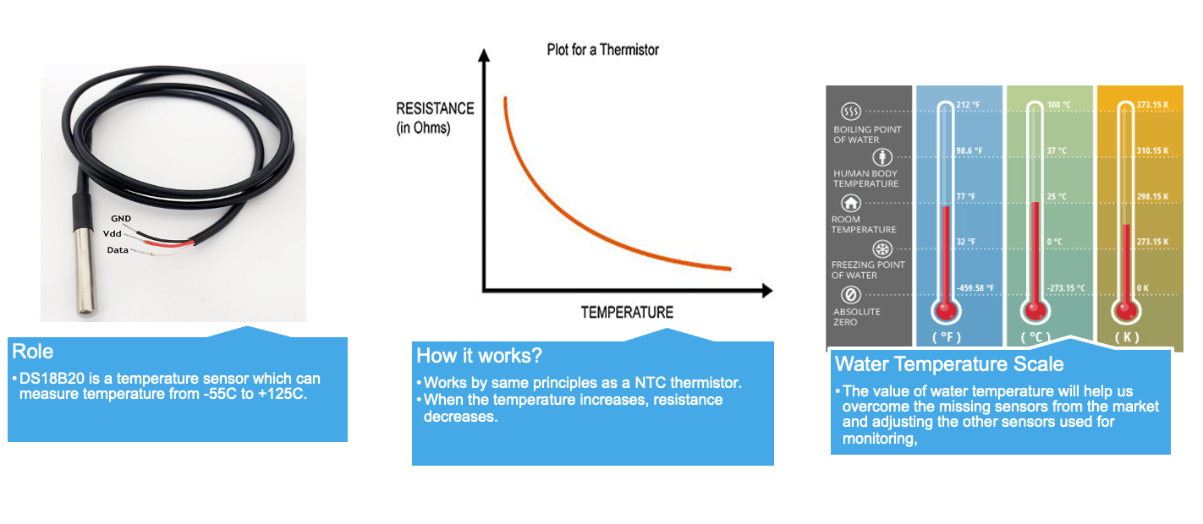
Water Temperature Sensor

Slide 20
Missing Sensors & How to overcome them
Water Dissolved Oxygen Sensor
Missing Sensor
Combination of TDS & Water Temperature Readings
Our Solution
- As temperature decrease and TDS mg/L(ppm) value decrease the percentage of dissolved oxygen increase.
- If TDS reading between 0-400 ppm & temperature between 5ºC to 30 ºC percentage of oxygen will be between 8 & 15 mg/L.
- Drinking water dissolved oxygen value is between 7.5 & 9 mg/L.
Outcome

Slide 21
Missing Sensors & How to overcome them
Water Conductivity Sensor
Missing Sensor
Combination of TDS & Water Temperature Readings
Our Solution
- The more salts are dissolved in the water, the higher is the value of the electric conductivity.
- TDS (mg/L) = k EC (µS/cm) at 25ºC. Where EC is electric conductivity.
- Drinking water conductivity value is 200 to 800 µS/cm.
Outcome

Slide 22
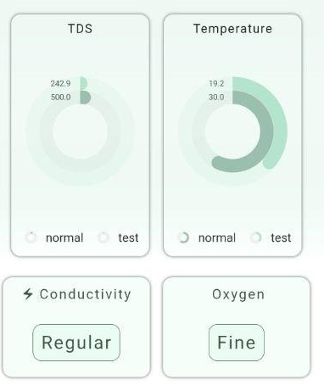
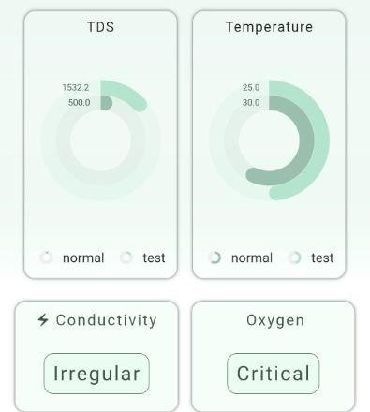
Results from mobile app

Slide 23
03
Mobile Application

Slide 24
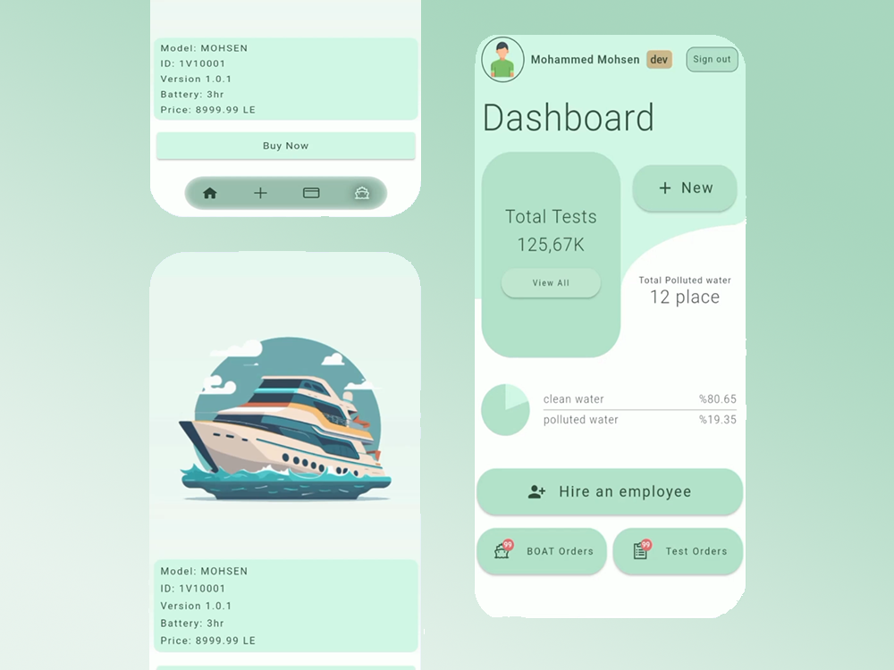

Slide 25
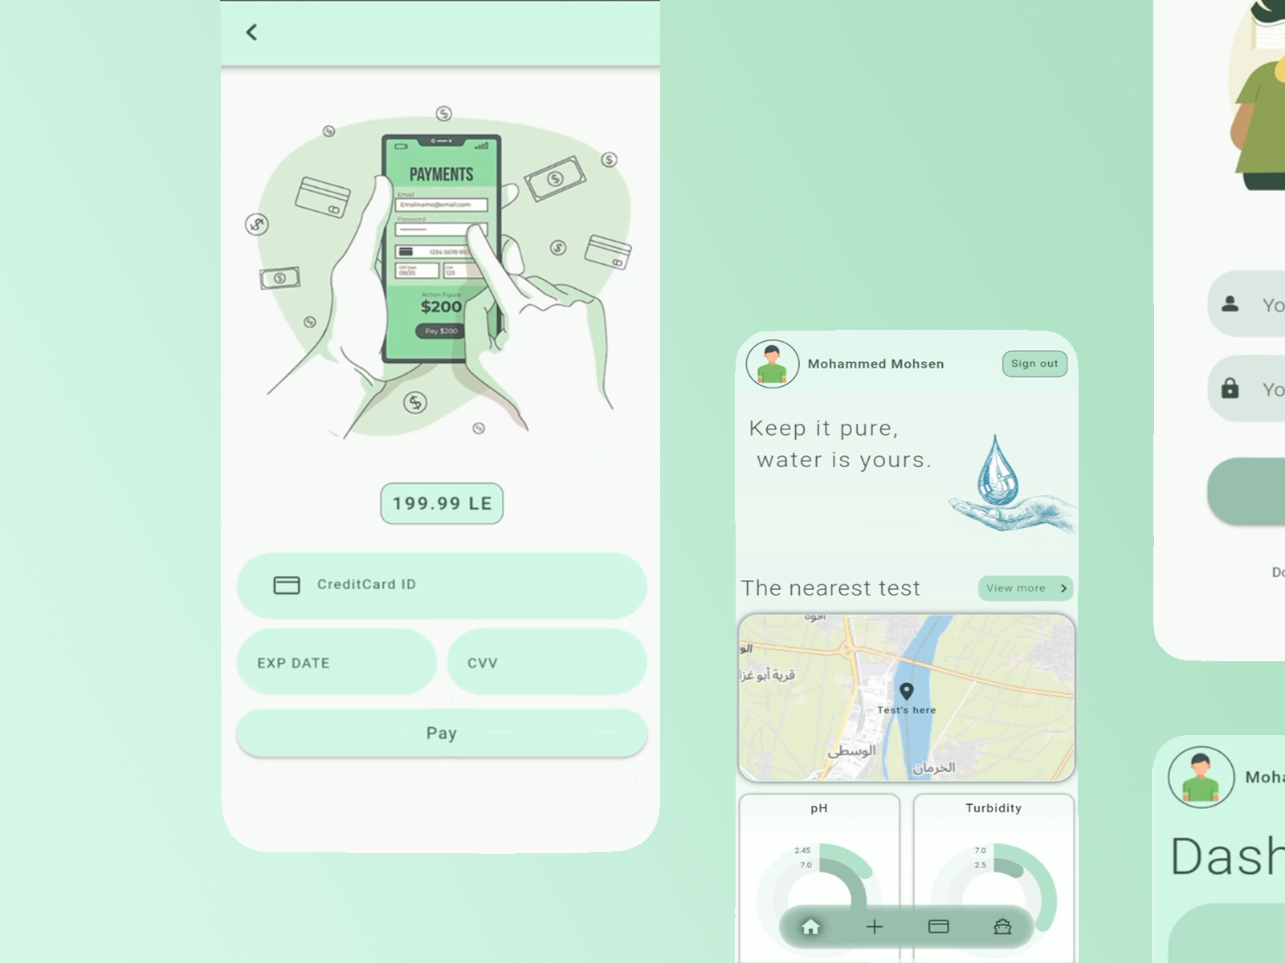

Slide 26
04
HW Implementation

Slide 27
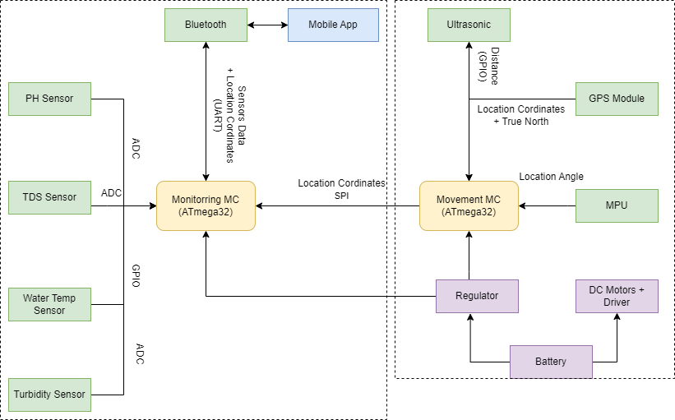
HW Block Diagram

Slide 28
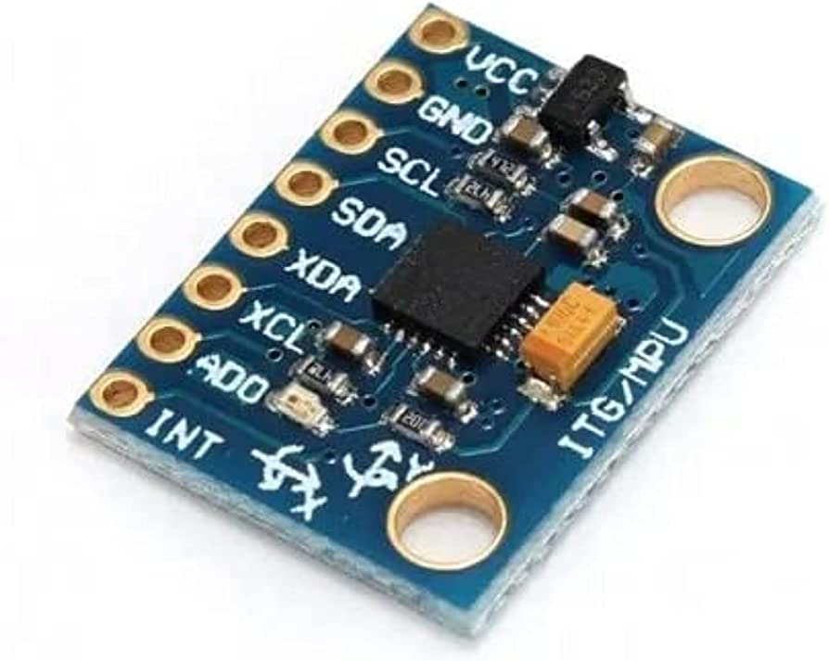
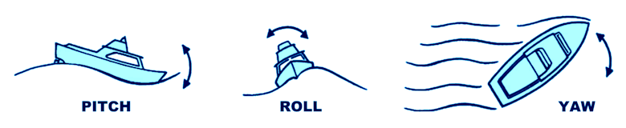
MPU Sensor (Motion Processing Unit)
3 in 1 sensors: ACC, Gyro and Mag.
Gets Yaw, Pitch and Roll angles.
Supply on 3.5-5 V and 3.5 mA.
Real Time Motion Angle.
Internal Measurement Unit (IMU)

Slide 29
05
Business Plan

Slide 30

Business Plan
Market Research Summarize the market research conducted, including the size of the market, and target audience. Highlight any trends or opportunities that support the viability of the project.
Market Size: The market size for water quality monitoring can vary depending on the specific application and geographic region. Water quality monitoring is conducted in various sectors, including environmental monitoring, industrial processes, agriculture, and public health. The market size could range from local applications, such as monitoring a specific body of water, to larger-scale applications covering multiple regions or countries. Target Audience: The target audience for a project involving a boat with water quality sensors can be diverse and depend on the purpose of the monitoring. Potential stakeholders may include government agencies responsible for environmental regulation, water treatment facilities, research institutions, environmental consulting firms, and industries relying on clean water sources. Trends and Opportunities: There are several trends and opportunities that support the viability of a project focusing on water quality monitoring: Increasing Environmental Concerns: Growing awareness about the importance of water quality and its impact on ecosystems, human health, and industries has led to an increased demand for monitoring solutions. Regulatory Compliance: Governments and regulatory bodies worldwide are implementing stricter regulations and guidelines related to water quality. This creates opportunities for companies providing water monitoring solutions to help meet compliance requirements.

Slide 31
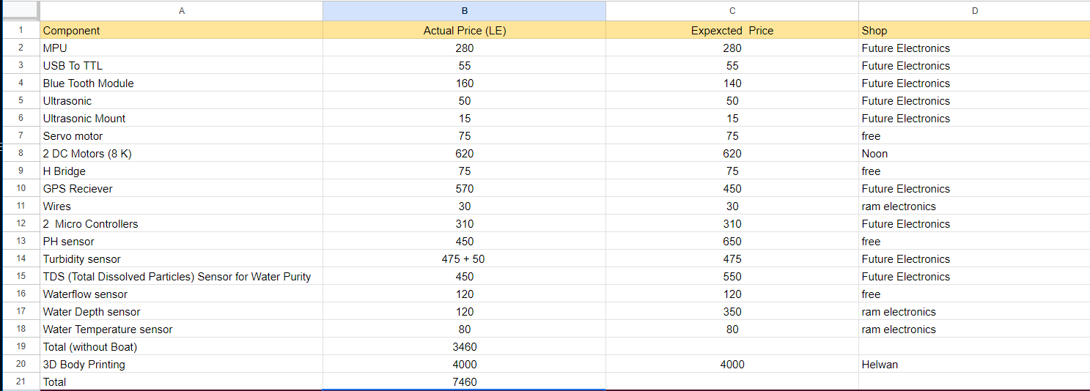
Business Plan
Financial Projections Financial Goals - Budget in Detail - Future Plans
Financial Goals: covering the initial investment, maintaining and upgrading sensor equipment, funding ongoing operational expenses, and ensuring long-term sustainability. Define objectives related to revenue generation, if applicable, such as monetizing collected data or offering consulting services based on the insights obtained. Consider long-term financial goals beyond the project, such as saving for future expansions or diversifying revenue streams. Budget in details:

Slide 32
Business Model Canvas |  |  | Team: ASWQM
Key Partners 1- Sensor Manufacturers 2-Technology Providers 3- Water Quality Monitoring Stations 4-Distributors | Key Activities 1- Hardware Development 2-Software Development 3-Data Transmission & Analysis | Value Propositions -Advanced Water Quality Monitoring -Remote Monitoring and Control -Cost-Effective Solution -User friendly Visualization | Customer Relationships -Consultative Approach -Ongoing Support | Customer Segments 1-Environmental Agencies 2-Households 3-water treatment facilities 4-Water Resource Managers 5-Research Institutions 6- industries relying on clean water sources
 |  |  | Channels -Direct Sales -Boat Booking -Online Platforms(Mobile apps)
 | Key Resources -Hardware Components -Software Systems
Cost Structure -Component Costs -Operations and Maintenance costs -Technical work costs -Research and Development |  |  | Revenue Streams -Product Sales -Boat Booking -Service Contracts

Slide 33
06
Future Work

Slide 34
FUTURE WORK
Future work will include the following
1. Use satellite Communication(Antenna) instead of bluetooth for further distance.
2. Establishment of Product Line.
3. Adding Ultrasonic waterproof to avoid underwater obstacles.
4. Adding more water quality sensors for more efficient monitoring such as
a.Radiation Sensor b.Nutrient Sensors
c.Water Dissolved Oxygen d.Water Conductivity Sensor
e.Oil and Hydrocarbon Sensors

Slide 35
Thanks

